Slide 1

COREGISTRATION
Indian Institute Of Technology, Bombay
For Prayagraj (A and B)
Student Name: Riya Sunil Kharade
Guided BY : Prof. Gulab Singh
Subject : Microwave Satellite Data Processing

Slide 2
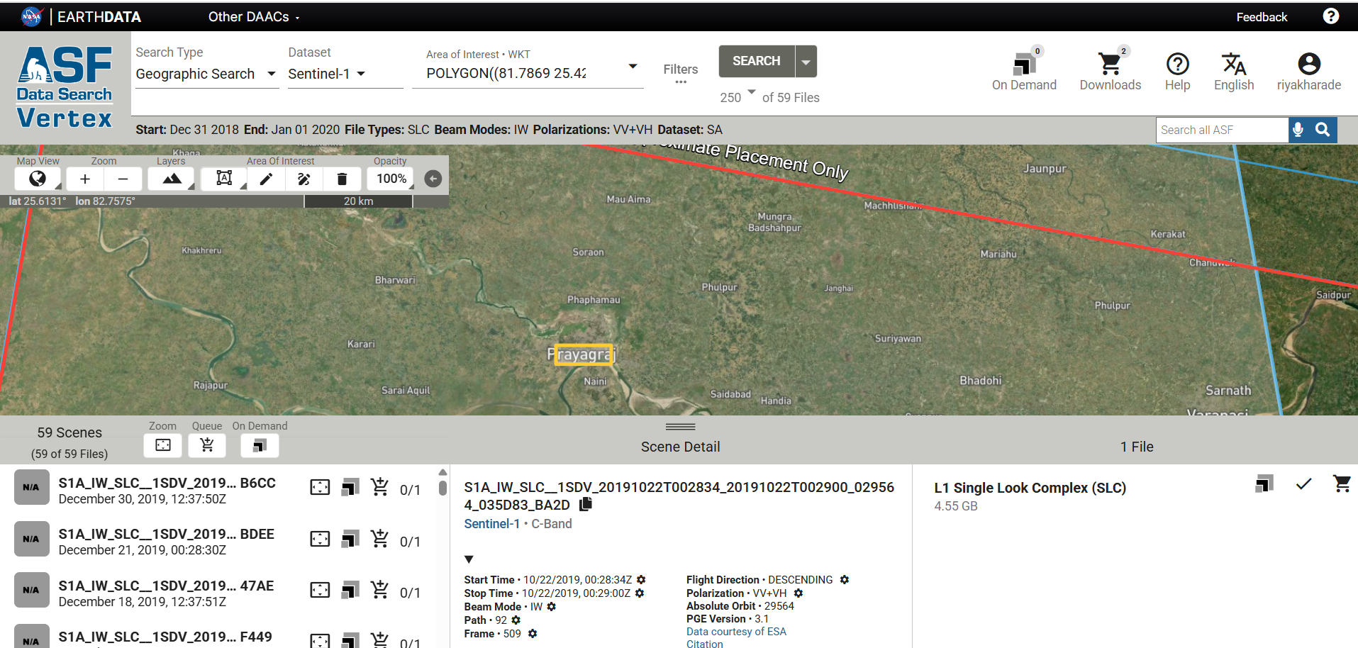
Data Downloading Using ASF for Prayagraj

Slide 3
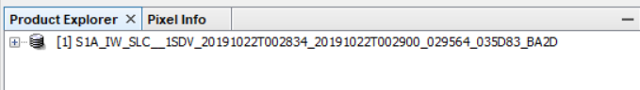
Import S1 A and B Data /S1 Tops- Split
Drag and Drop folder

Slide 4
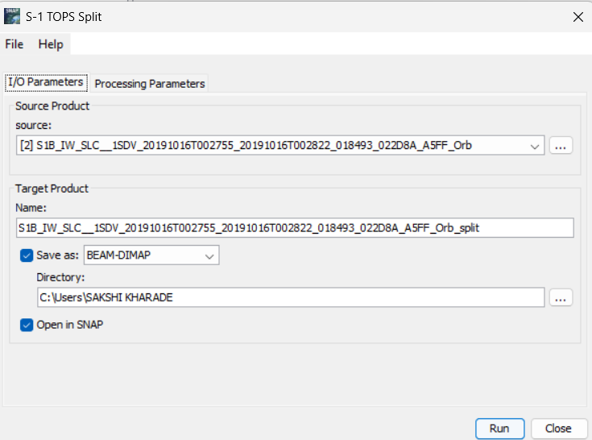
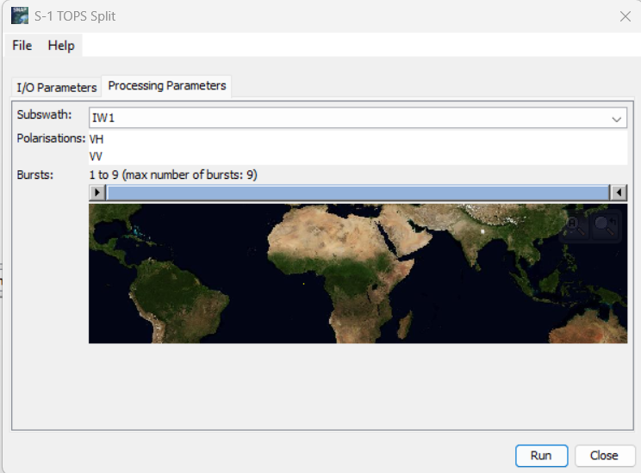
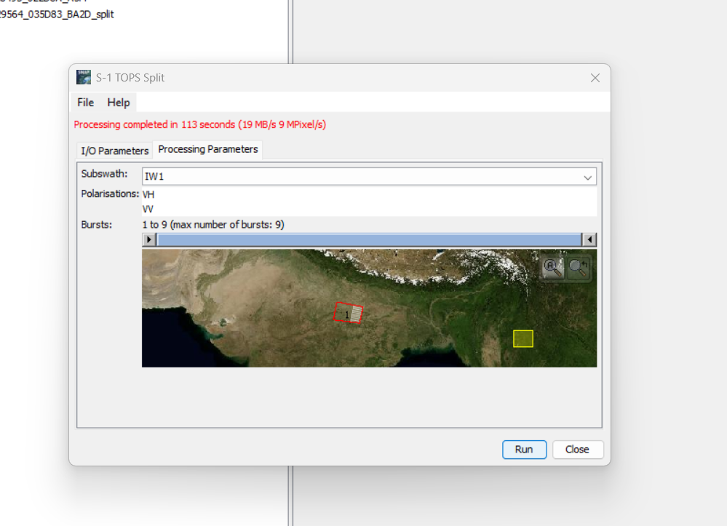
Step 2: Split (For A and B)
Radar-Sentinel 1 TOPS – S1 TOPS Split

Slide 5
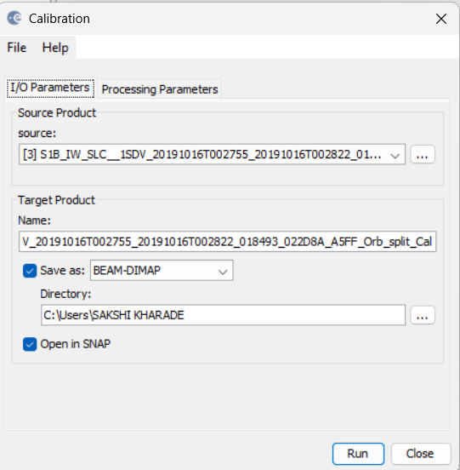
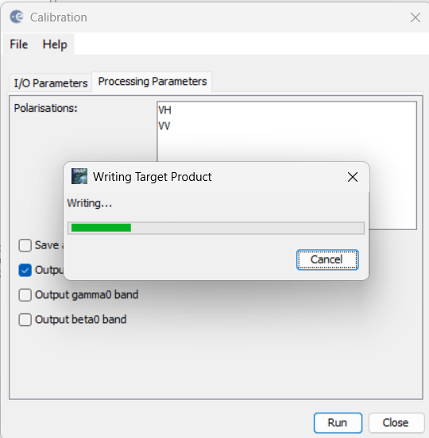
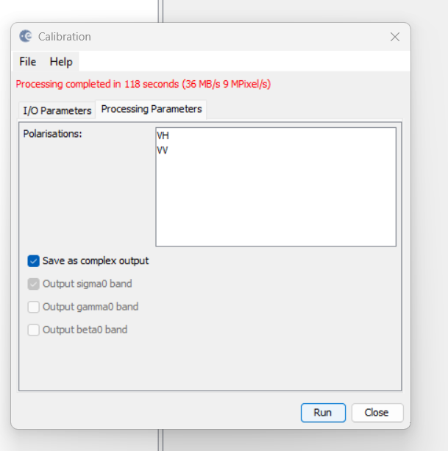
Step 3: Calibration (For A and B)
Radar-Radiometric-Calibration

Slide 6
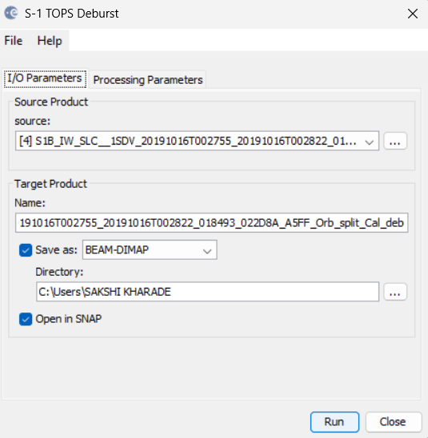
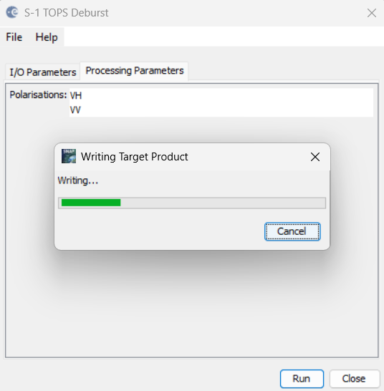
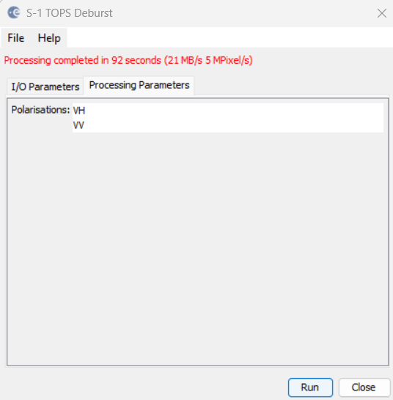
Step 4: Deburst
Radar-Sentinel 1 TOPS- S1 TOPS Deburst

Slide 7
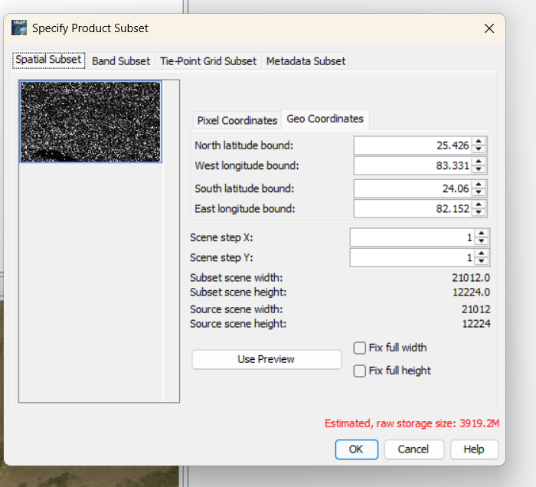
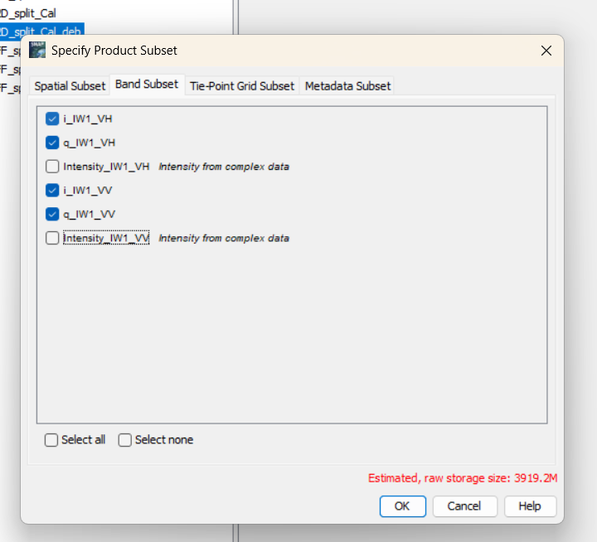
Step 5: Subset
Radar-Subset

Slide 8
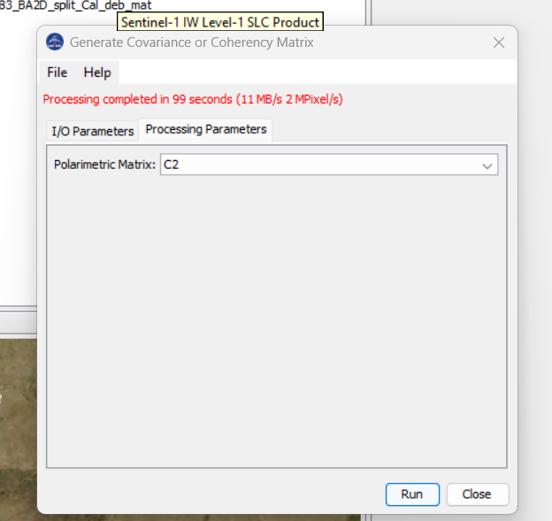
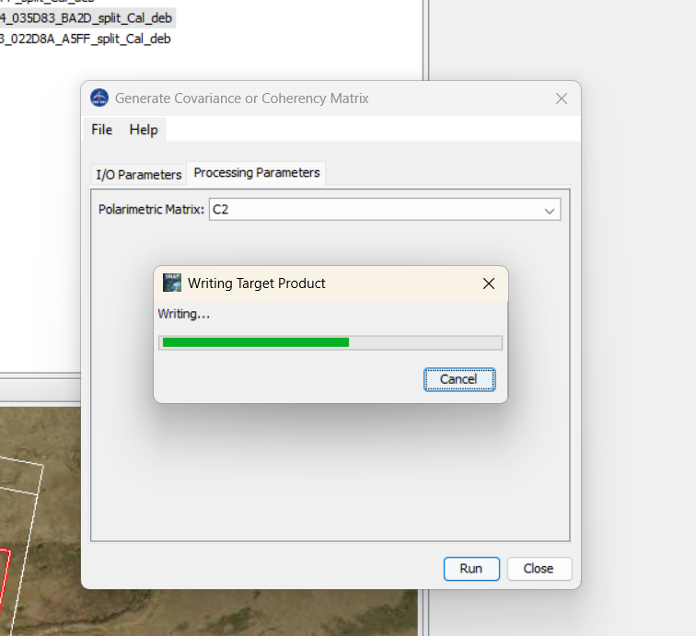
Step 6: Matrix
Radar-Polametric-Matrix

Slide 9
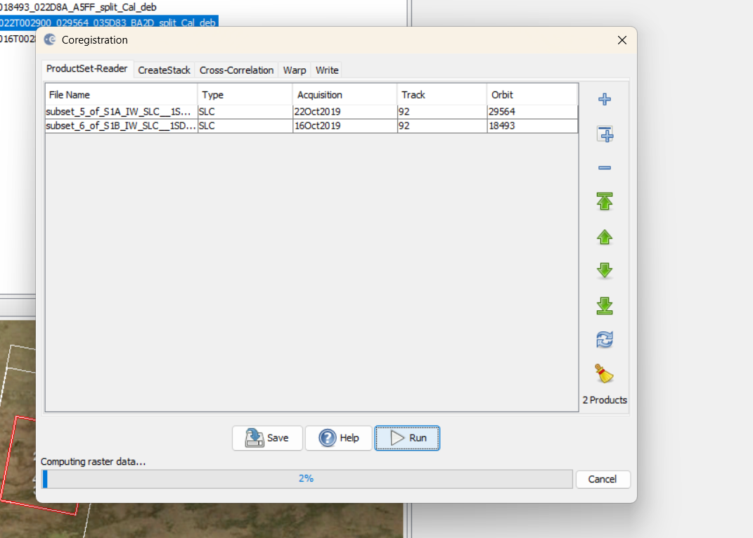
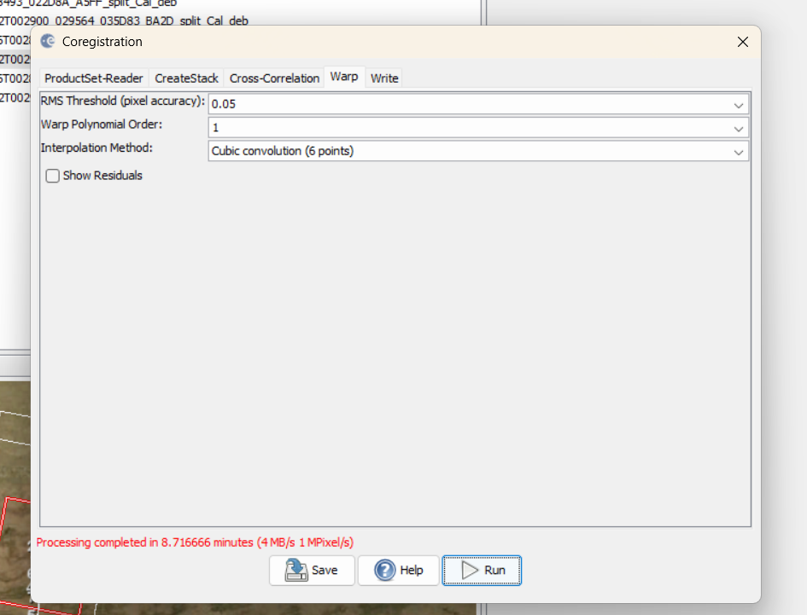
Step 7: Coregistration
Radar-Coregistration-Coregistraion

Slide 10
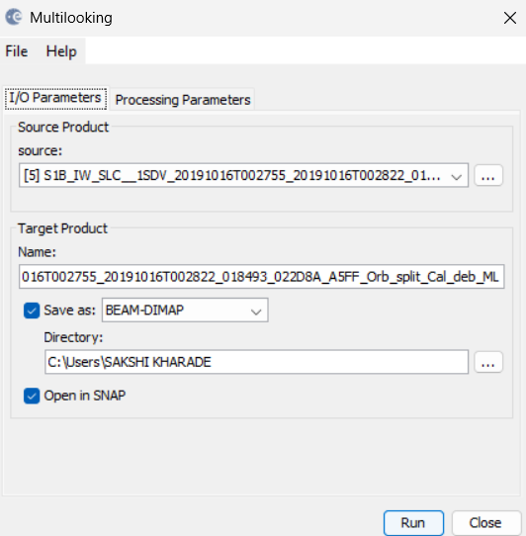
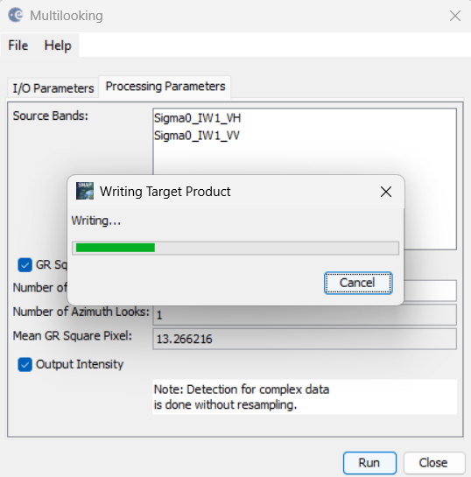
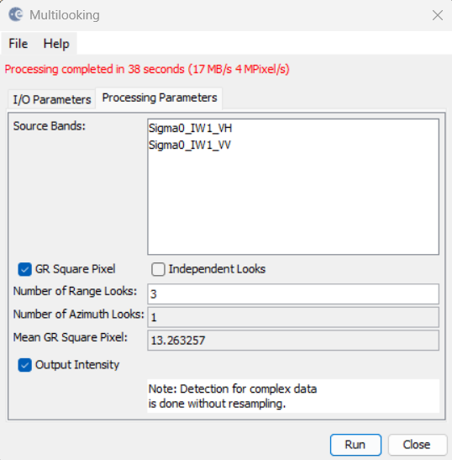
Step 8: Multilooking
Radar-SAR Utilities-Multilooking

Slide 11
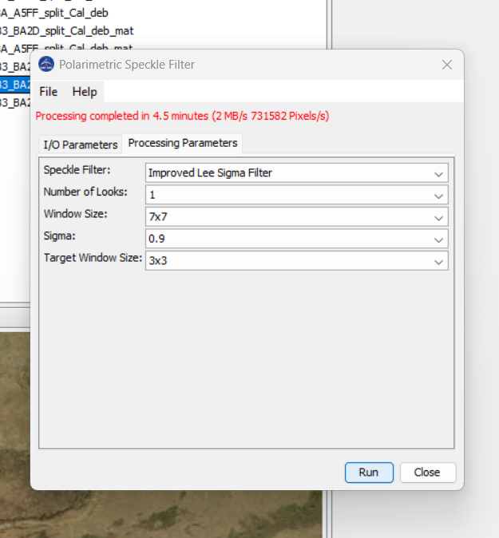
Step 9: Speckle
Radar-Polarimetric-speckle

Slide 12
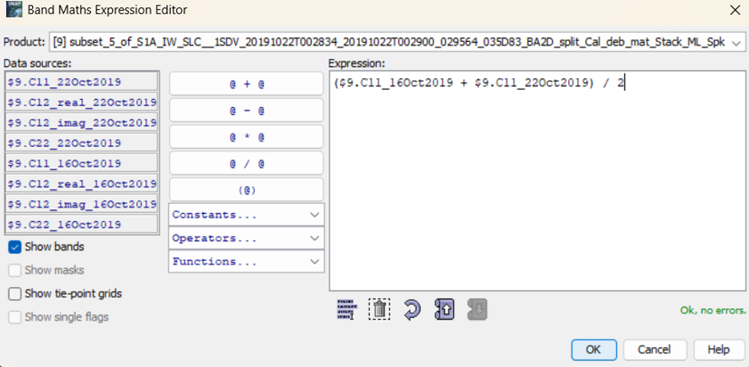
Band Math

Slide 13
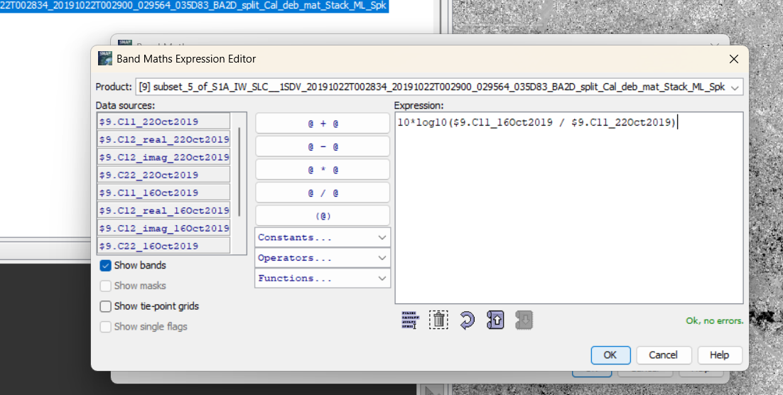
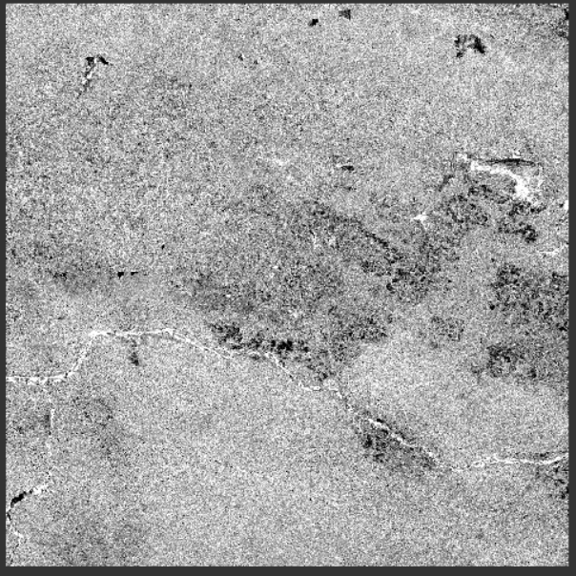
Band Math

Slide 14
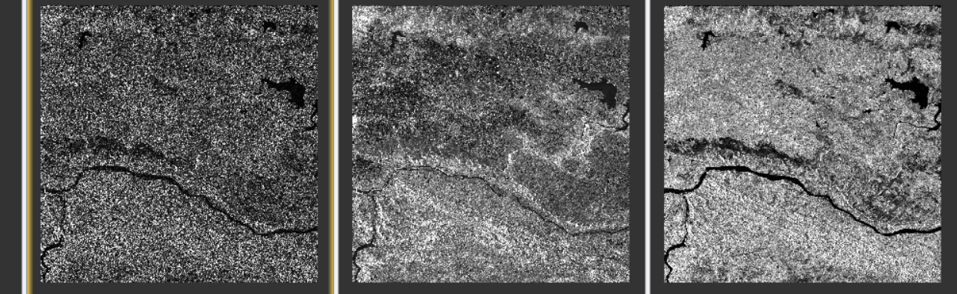
Band Math for Old
pc
pg
pv

Slide 15
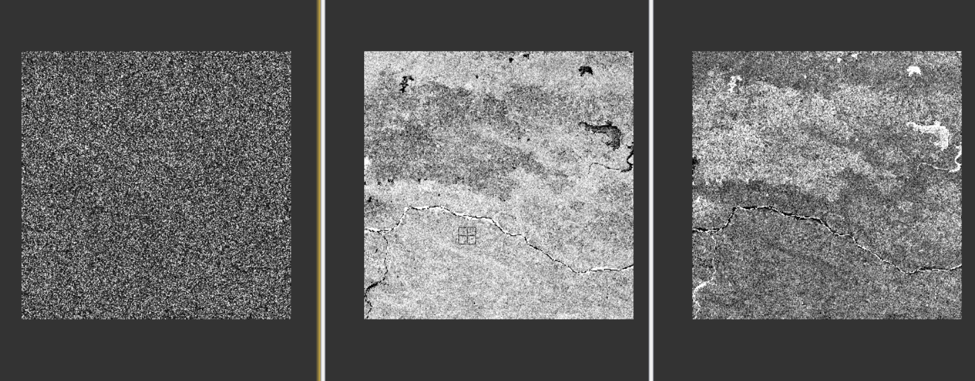
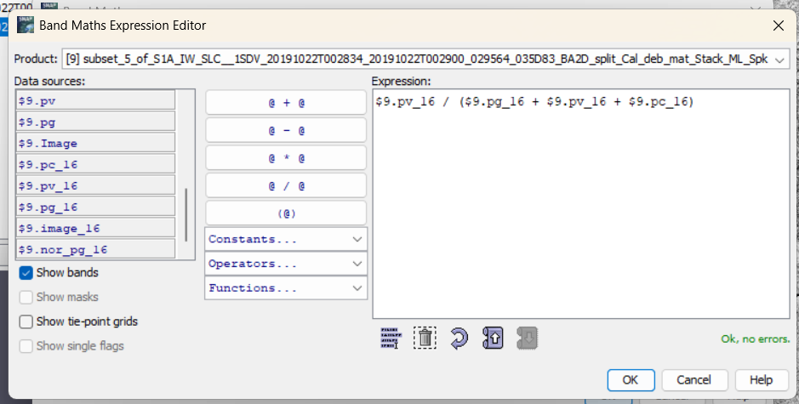
Band Math for Old Normalized
pc
pg
pv

Slide 16
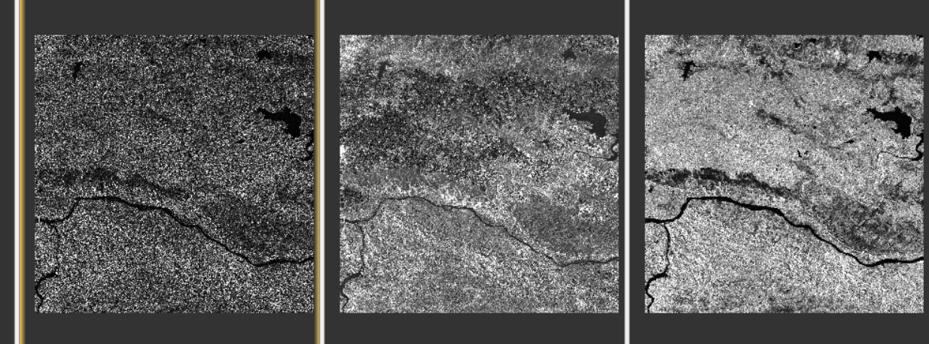
Band Math for Previous
pc
pg
pv

Slide 17
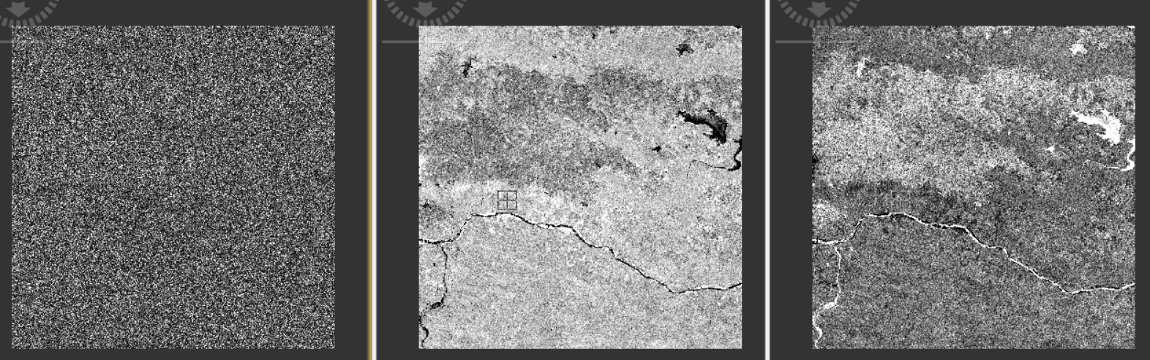
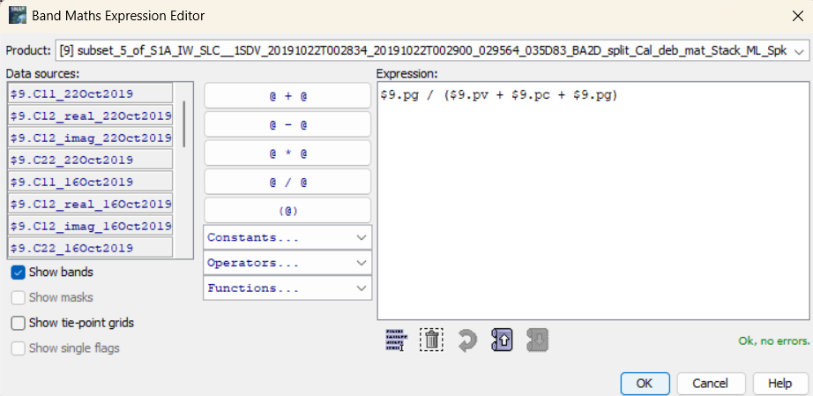
Band Math for Previous Normalized
pc
pg
pv

Slide 18
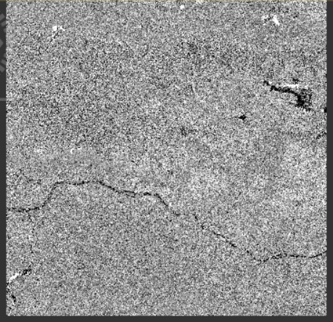
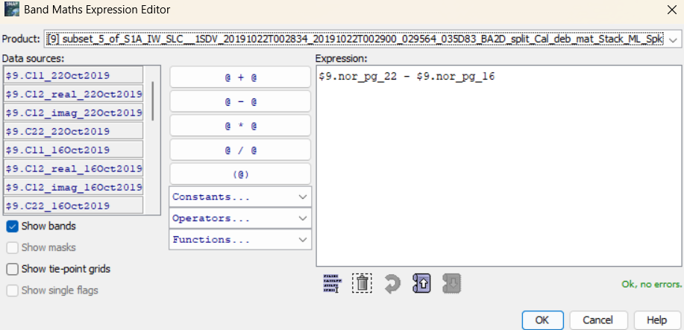
Band Math for Normalized Difference
pg

Slide 19
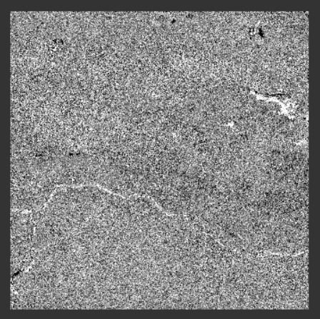

Band Math for Normalized Difference
pv

Slide 20
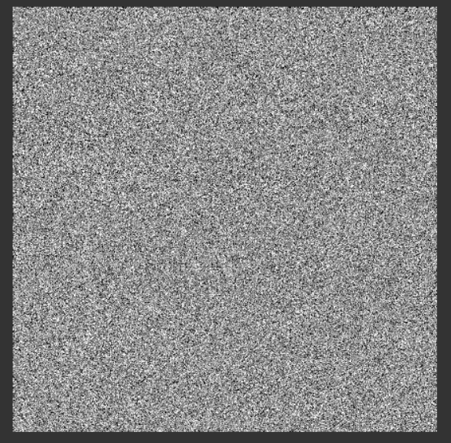
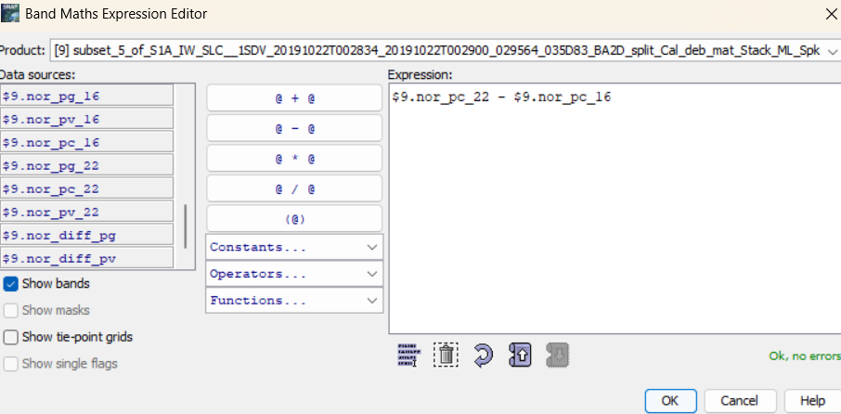
Band Math for Normalized Difference
pc

Slide 21
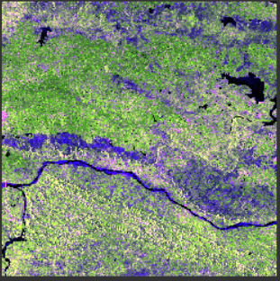
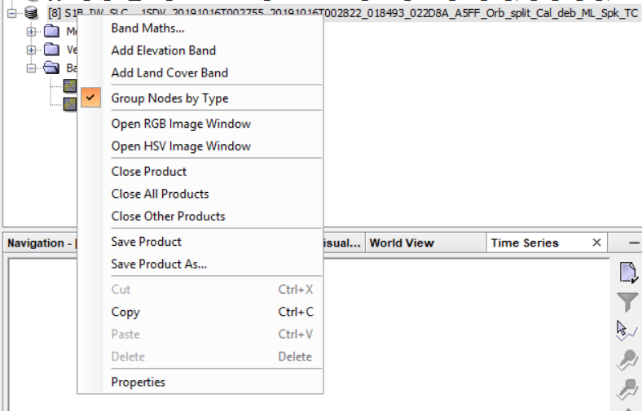
Step 10: RGB Image Window
Right Click On TC file-Open RGB Image Window

Slide 22
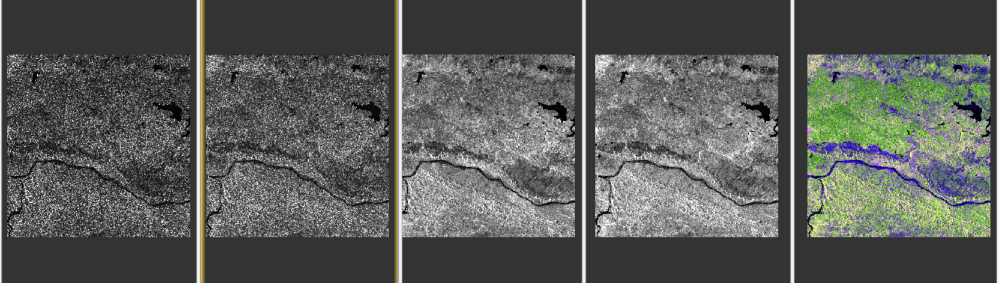
Step 11: Comparison
ORIGINAL MULTILOOKING
TIME AVG MULTILOOKING
ORIGINAL SPK
TIME AVG SPK
RGB

